Slide 1
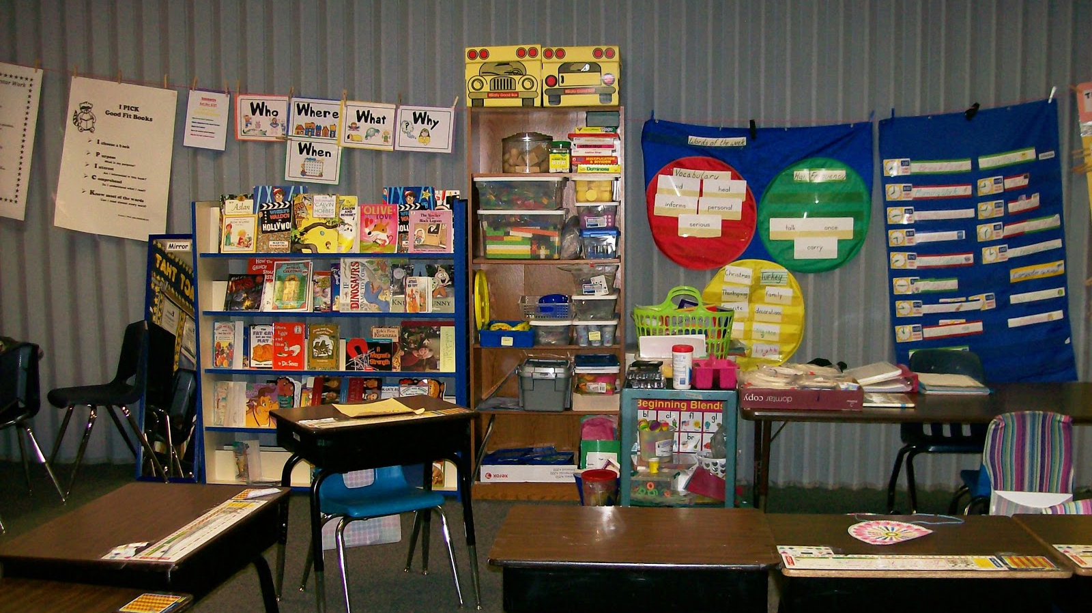
A career in education
This Photo by Unknown Author is licensed under CC BY-SA

Slide 2
Think back to a time when you helped someone
This Photo by Unknown Author is licensed under CC BY-ND
Notes:
Pose this as a question – discuss in pairs or small groups. What did you do to help? How did you do it? How did the person/people react to your help?

Slide 3
Have you taught someone a skill?
This Photo by Unknown Author is licensed under CC BY-NC
Notes:
What skills have you learned? These could be any skill, not just school based. Has anyone taught someone a skill? Can you describe what you did, the process involved, how long it took, did the person learn this new skill?

Slide 4
Who was your favourite teacher?
Notes:
Discussion with whole class – who was your favourite and why?

Slide 5
What are the qualities of a good teacher?
This Photo by Unknown Author is licensed under CC BY-ND
Notes:
In pairs, discuss what a teacher is. The job they do, what skills do teachers have, who makes a good teacher, why? List the qualities they consider teachers should have. This could then lead to an infographic displaying the qualities a teacher should have.
This could be followed by one of our teacher trainee videos talking about ‘What are the skills and qualities of a good teacher?’

Slide 6
Why be a teacher?
Make a difference
Your passion for learning
Work anywhere in the world
Career opportunities
Every day is different
Notes:
Discuss each point in turn.

Slide 7
What do trainee teachers have to say?
This Photo by Unknown Author is licensed under CC BY-SA-NC
Notes:
At this point you could watch the videos of our current trainee teachers talking about teaching.
What are the skills and qualities of a good teacher?
What does being a teacher mean to you?
What is the academic side of teacher training involve?
What is the best part of work placements?
Why did you decide to go into teaching?

